Slide 1
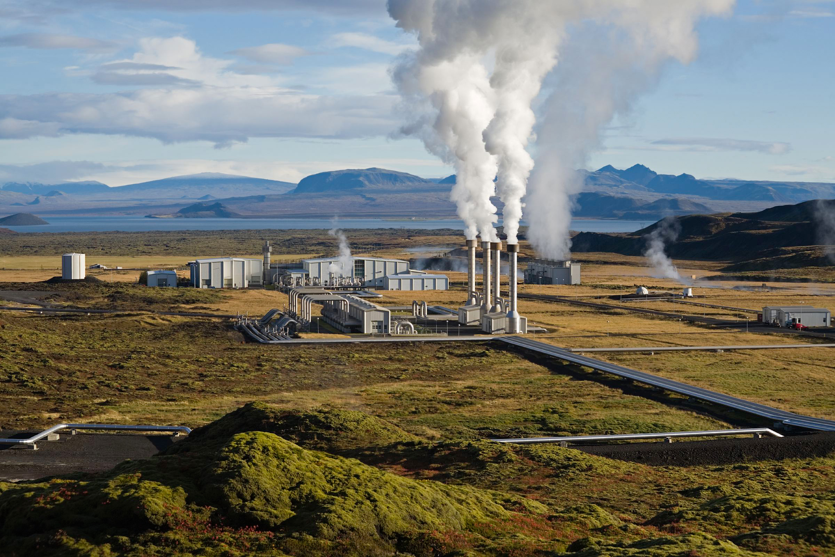
Shallow Geothermal Energy Development
By Ifeanyi Francis Izuegbunam
Clement
https://github.com/Ifefr-codes/shallow-geothermal-energy

Slide 2
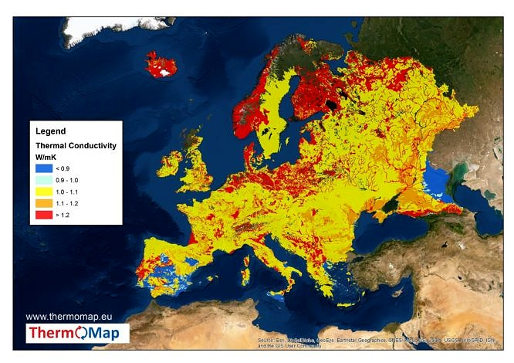
Introduction

Slide 3
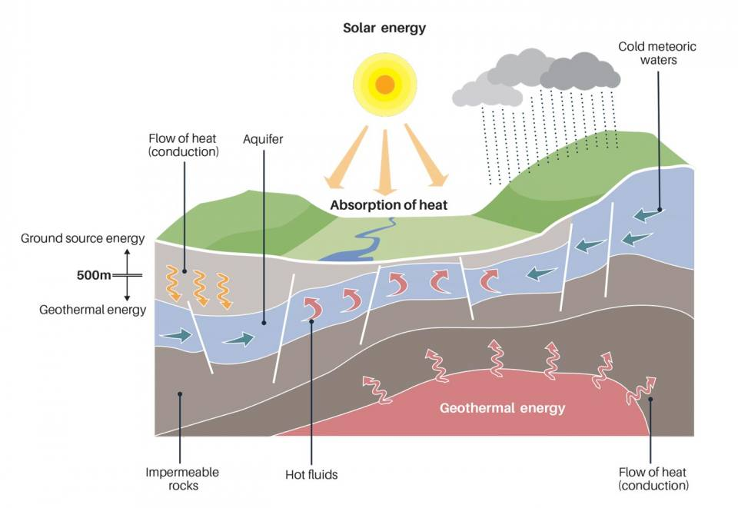
Introduction

Slide 4
Introduction

Slide 5
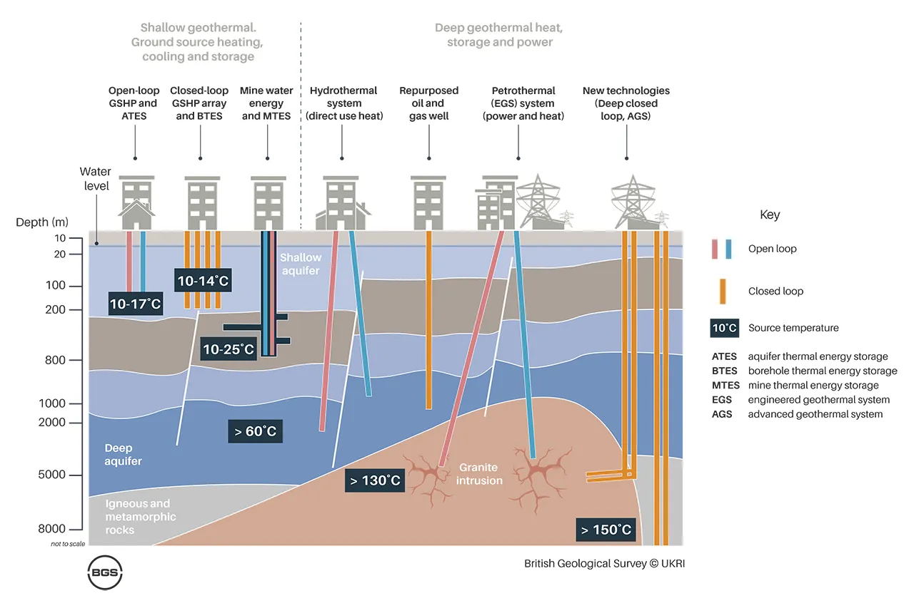
Principle of geothermal system

Slide 6
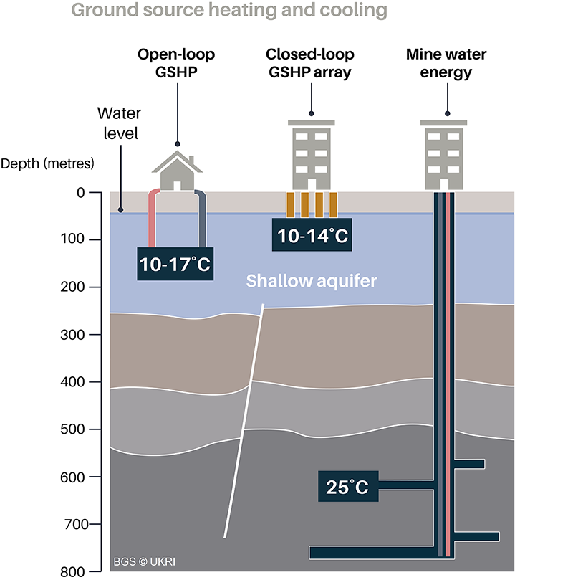
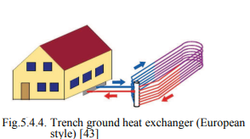
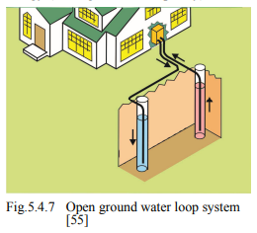
Very low temperature systems

Slide 7
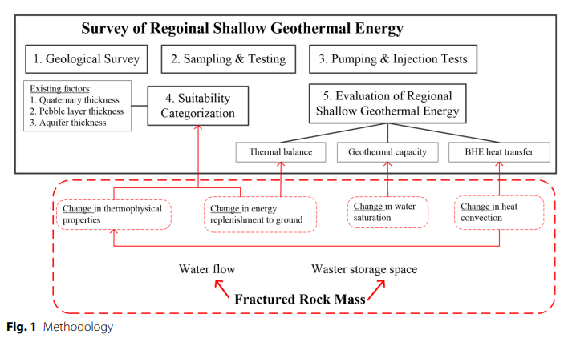
Geological context and petrophysical properties

Slide 8
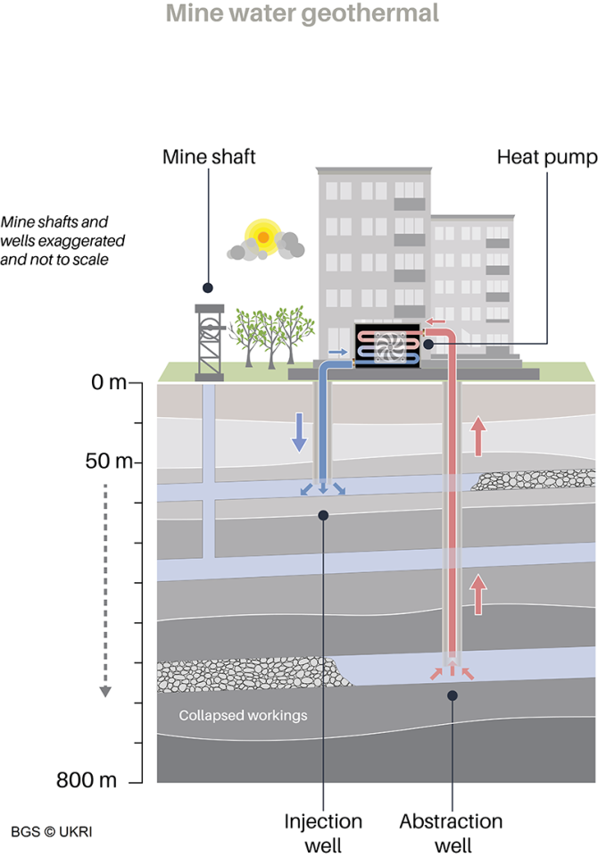
Low temperature systems

Slide 9
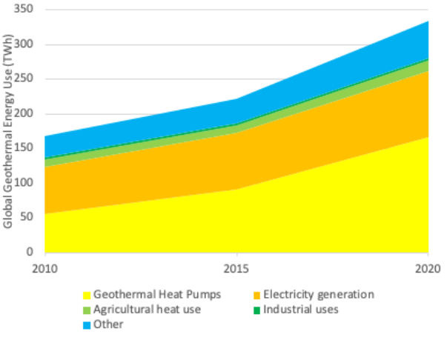
Development in the E.U.
EU Shallow Geothermal Policy & Development
Binding renewable energy targets (RED III) drive member state action for heating decarbonization
Permitting guidelines aim to accelerate project approval and reduce bureaucracy
National momentum is building, by Germany’s new law to fast-track geothermal
Strategic EU support continues via JRC reports and Interreg knowledge-sharing projects

Slide 10
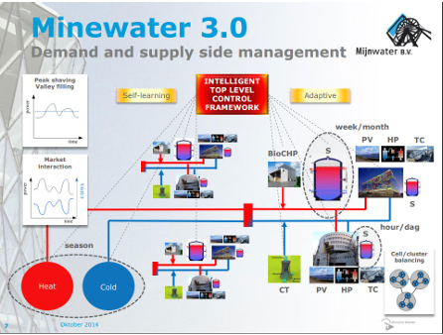
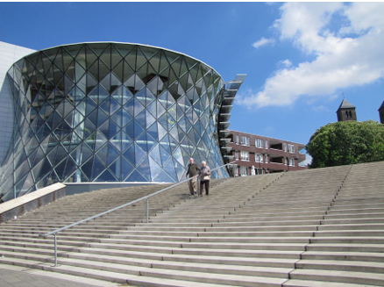
Advantages, drawbacks, and prospects: Case 1
Mijnwater, Heerlen (NL) – Project start 2008
Merits: Uses local renewable resource, low running emissions, first mover 5GDHC example and strong EU/EIB support for scaling
Hurdles: Yields variability/decline; need for building retrofits for low temperature supply; operational maintenance; permitting and stakeholder coordination
Prospectives: phased expansion plus monitoring, building retrofit/incentive programs, robust water management, blended financing and replication via EU projects

Slide 11
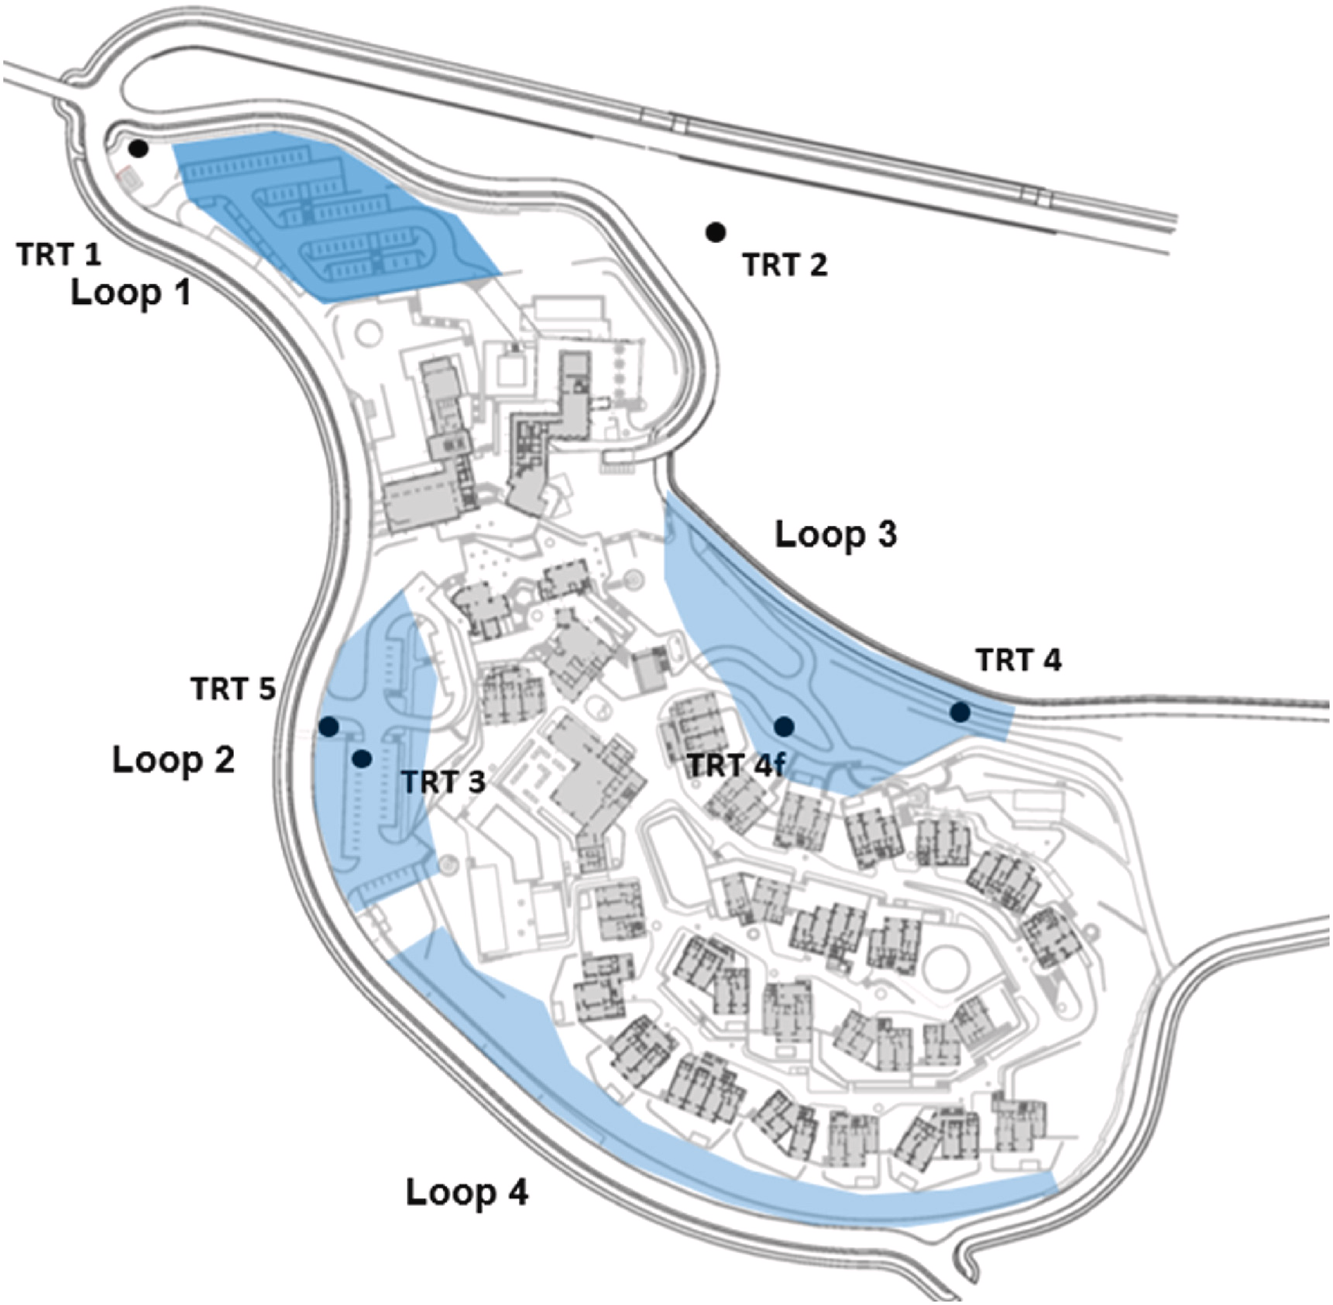
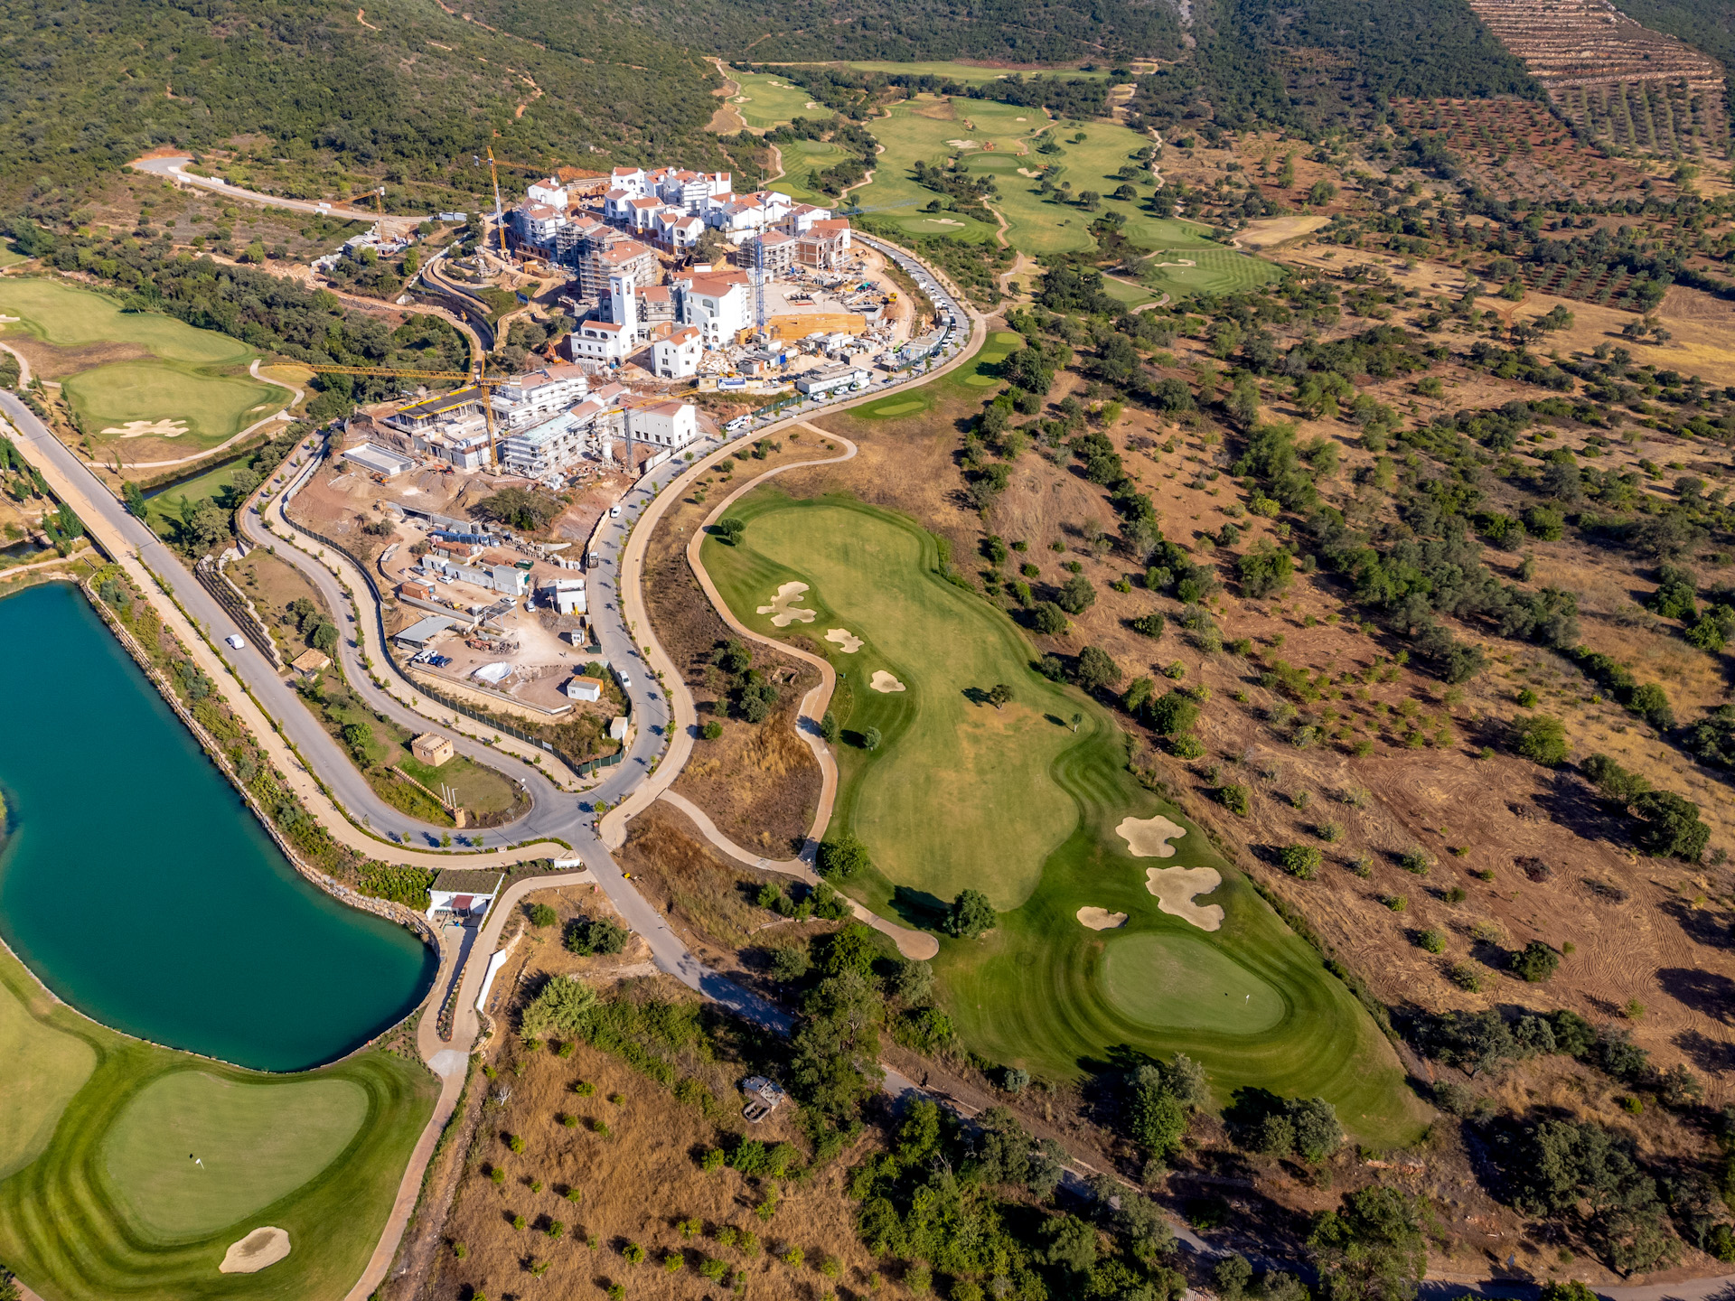
Advantages, drawbacks, and prospects: Case 2
Geothermal Energy at Ombria Resort (PL) - A Sustainable Path for Luxury Eco-Tourism
Merits: Aligns with sustainable brand, cutting carbon footprint, reduces long-term energy costs, and boosts guest comfort
Hurdles: High upfront investment, installation cost, and complex local geology requires specialized expertise due to Algarve’s karstic limestone
Prospectives: Implementation via modular phased rollout, accessing green grants and EU funding programs

Slide 12
Other notable global projects:
Shallow Geothermal System in Elizabeth Blackburn School of Sciences
Richard Stockton College (USA)
The Sphinx Observatory (Switzerland)
Reykjavik’s Geothermal Wells (Iceland)
Beijing Daxing Airport (China)
Messe Graz Congress Center (Austria)

Slide 13
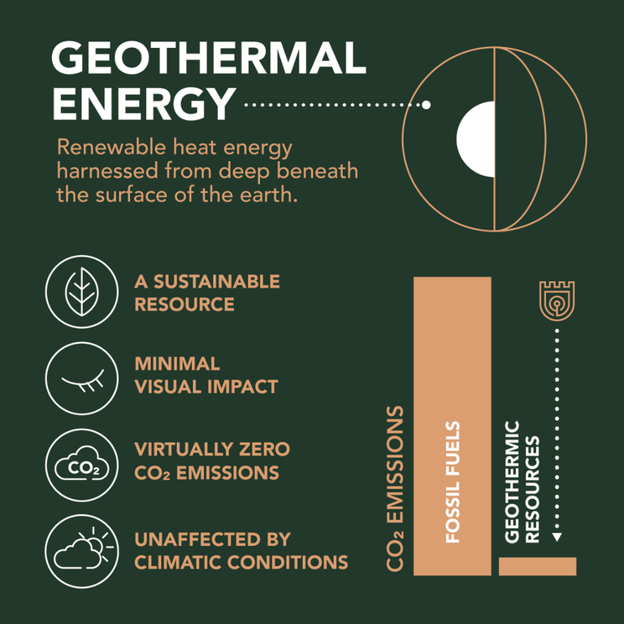
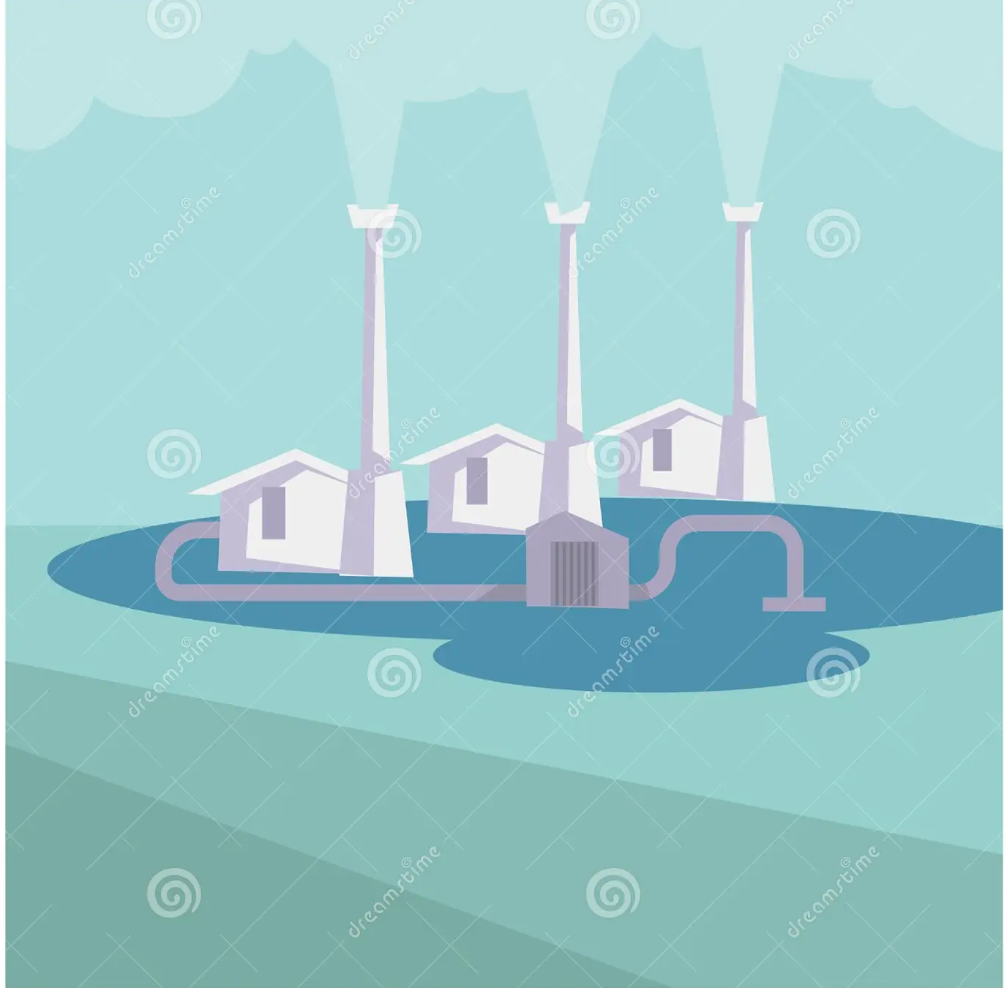
Conclusion
UNLOCK SHALLOW GEOTHERMAL’S POTENTIAL FOR WIDESPREAD, CLEAN HEATING AND COOLING
Project we have: A Python script that demonstrates shallow geothermal energy concepts and calculations

Slide 14


Videos on some great projects:
Notes:
https://youtu.be/GUy5o_-uMEk?list=TLGGiB4Qt10je6wxOTExMjAyNQ https://www.ombria.com/en/about/sustainability/geothermal-energy/ https://youtu.be/Plc0GmWmUPQ?si=-RIBNI6igFlU6WOF Shallow Geothermal System in Elizabeth Blackburn School of Sciences

Slide 15
Resources used
https://www.bgs.ac.uk/geology-projects/geothermal-energy/applications/
https://eurogeologists.eu/esteban-shallow-geothermal-energy-geological-energy-for-the-ecological-transition-and-its-inclusion-in-european-and-national-energy-policies/
https://geocom.geonardo.com/assets/elearning/6.22.Shallow%20Geothermal%20SYstems.pdf
https://causewaygt.com/2023/02/geothermal-system-archetypes-classification-applications-and-technology-development-opportunities/
https://www.eurelectric.org/in-detail/what-is-geothermal-power/
https://nfp-energie.ch/fr/dossiers/192/cards/381
https://mijnwater.com/over-mijnwater/projecten
https://storm-dhc.eu/en/mijnwater-bv-site
https://www.ombria.com/en/about/sustainability/geothermal-energy/#:~:text=Our%20low-impact%20geothermal%20system%20supplies%20safe%2C%20clean%20renewable,and%20preserving%20the%20unique%20biodiversity%20of%20our%20region.
https://youtu.be/GUy5o_-uMEk?si=BUHEJyj_VOBE88aO
https://www.ombria.com/en/blog/interview-geothermal-energy-ombria-resort/
https://ar.inspiredpencil.com/pictures-2023/geothermal-energy-renewable

